Slide 1
Week at A Glance for Science
August
29 -
September 2
Earth’s Changing Landscape

Slide 2
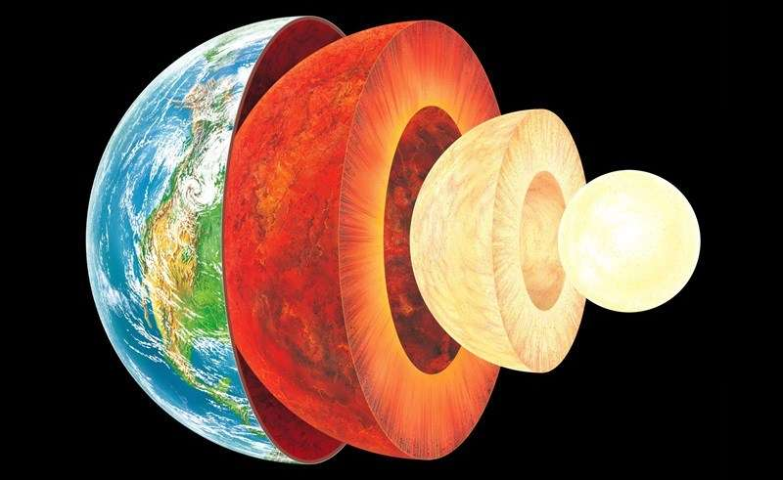

Slide 3
S6E5. Obtain, evaluate, and communicate information to show how Earth’s surface is formed.
Ask questions to compare and contrast the Earth’s crust, mantle, inner and outer core, including temperature, density, thickness, and composition.
c. Construct an explanation of how to classify rocks by their formation and how rocks change through geologic processes in the rock cycle.
f. Construct an explanation of how the movement of lithospheric plates, called plate tectonics, can cause major geologic events such as earthquakes and volcanic eruptions. (Clarification statement: Include convergent, divergent, and transform boundaries.)
Supporting Standards
b. Plan and carry out an investigation of the characteristics of minerals and how minerals contribute to rock composition.
g. Construct an argument using maps and data collected to support a claim of how fossils show evidence of the changing surface and climate of the Earth.

Slide 4
Monday, August 29
Standard: S6E5. a) Ask questions to compare and contrast the Earth’s crust, mantle, inner and outer core, including temperature, density, thickness, and composition.
Learning Target: I can describe Earth’s layers and composition.
Warm-up: Earth’s Layers Video
Work Session: Direct Instruction; students will take notes on Earth’s layers; Guided Instruction; students will use laptops to research; students will work on Study Guide.
Closing: Ticket Out the Door
Reminders: Quiz on Friday

Slide 5
Tuesday, August 30
Standard: S6E5. a) Ask questions to compare and contrast the Earth’s crust, mantle, inner and outer core, including temperature, density, thickness, and composition.
Learning Target: I can describe Earth’s composition.
Warm-up: Silent Reading from Textbook with questions
Work Session: Guided Instruction; students will research using computers; students will work on Study Guide
Closing: Student Summarize
Reminders: Quiz 9/2; Lab Day 9/1

Slide 6
Wednesday, August 31
Standard: S6E5.c Construct an explanation of how to classify rocks by their formation and how rocks change through geologic processes in the rock cycle
Learning Target: I can describe the rock cycle and how rocks change through geologic processes.
Warm-up: “The Rock Cycle” Video
Work Session: Small group (Reading/ Research: Textbook and Internet); Board Game; Study Guide
Closing: Class KWL chart
Reminders: Quiz 9/2

Slide 7
Thursday, September 1
Standard: S6E5.c Construct an explanation of how to classify rocks by their formation and how rocks change through geologic processes in the rock cycle
Learning Target: I can describe the rock cycle and how rocks change through geologic processes.
Warm-up: Rock Cycle Puzzle, Pangea Puzzle
Work Session: Direct Instruction: plate tectonics, fossils, the rock cycle, and minerals
Closing: Think-Pair-Share
Reminders: Quiz 9/2 activity due 9/7

Slide 8
Friday, September 2
Standard: S6E5. a,c
Learning Target: Investigate and engage in lab safety and lab project activity.
Warm-up: Lab Activity: “egg float” or “paper type, flaps, or design”.
Work Session: Quiz; Mini-lab activity (explore science equipment and materials). Students will start lab project.
Closing: Think-Pair-Share
Reminders: Quiz , asyncreonous activity canvass

Slide 9
Resources for Unit 1 A
What are the Layers of Earth?
Layers of the Earth
Layers of the Earth – Geology –
The Good and the Beautiful Home school Science 8:47
7 Ways We Know What’s Inside the Earth - SciShow 12:08
An Overview of Earth’s Layers - 10:07

Slide 10
S6E5. Obtain, evaluate, and communicate information to show how Earth’s surface is formed.
Ask questions to compare and contrast the Earth’s crust, mantle, inner and outer core, including temperature, density, thickness, and composition.
Plan and carry out an investigation of the characteristics of minerals and how minerals contribute to rock composition.
Construct an explanation of how to classify rocks by their formation and how rocks change through geologic processes in the rock cycle.
Ask questions to identify types of weathering, agents of erosion and transportation, and environments of deposition. (Clarification statement: Environments of deposition include deltas, barrier islands, beaches, marshes, and rivers.)
Develop a model to demonstrate how natural processes (weathering, erosion, and deposition) and human activity change rocks and the surface of the Earth.
Construct an explanation of how the movement of lithospheric plates, called plate tectonics, can cause major geologic events such as earthquakes and volcanic eruptions. (Clarification statement: Include convergent, divergent, and transform boundaries.)
Construct an argument using maps and data collected to support a claim of how fossils show evidence of the changing surface and climate of the Earth.
Plan and carry out an investigation to provide evidence that soil is composed of layers of weathered rocks and decomposed organic material.

